Slide 1
At the dentist’s

Slide 2
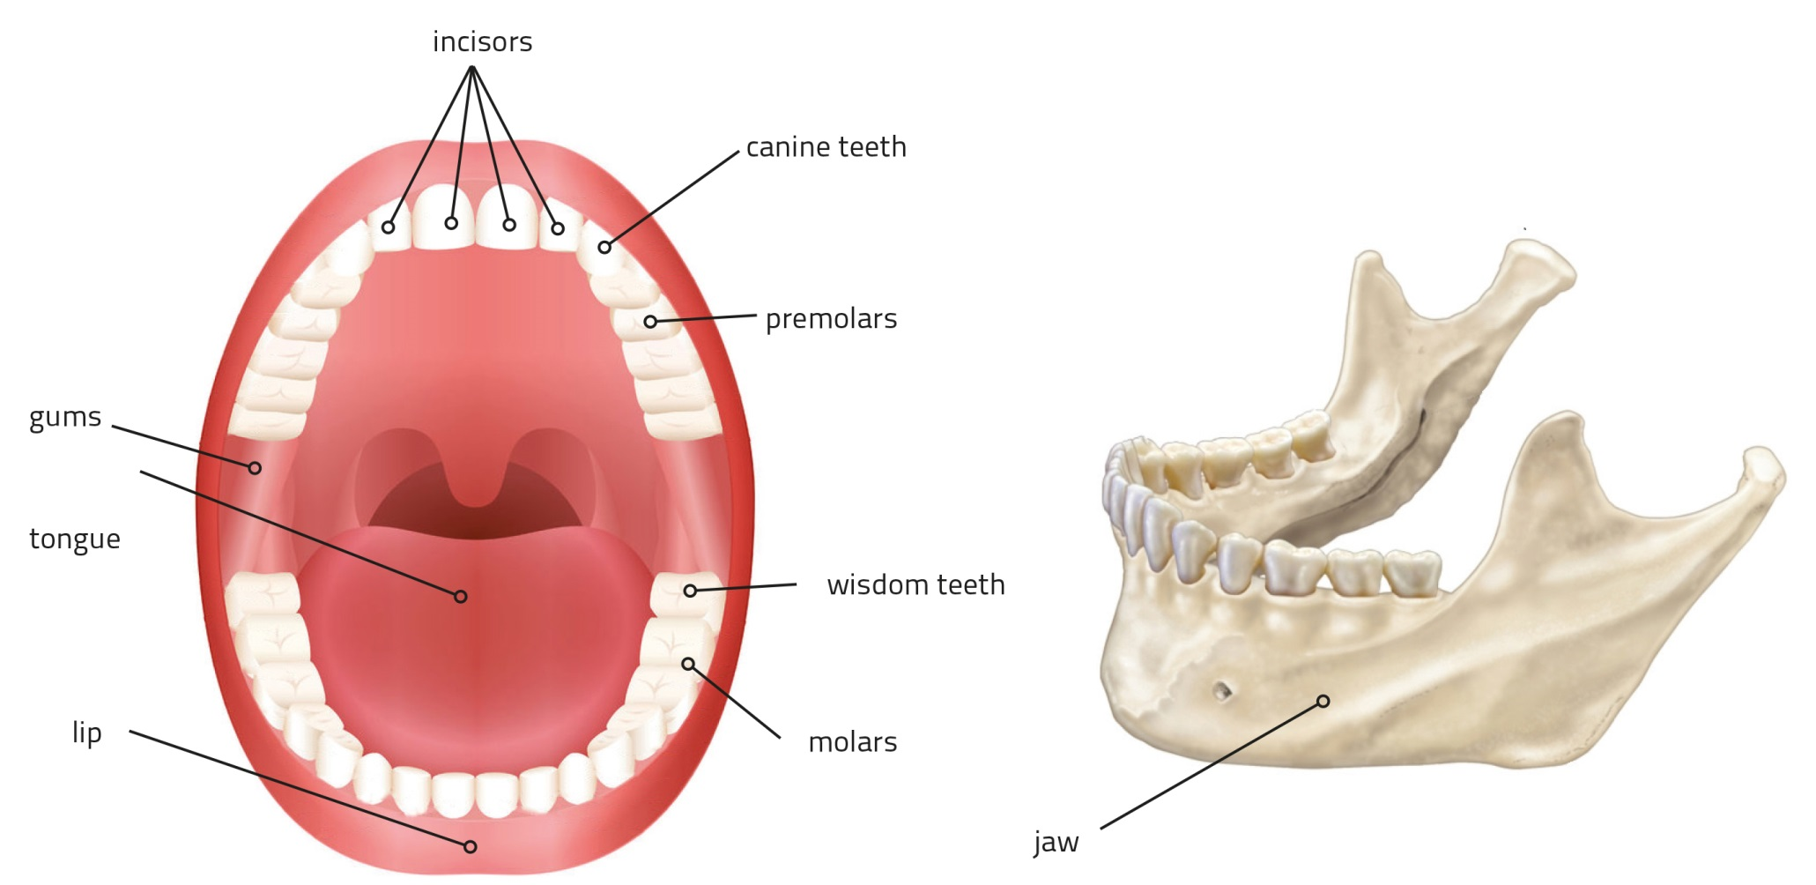
Inside your mouth

Slide 3
Read the article and fill in the gaps with appropriate words
I’ve got a cracked tooth. I think I need a c…………..
His teeth are all out of a………………... He’s going to need braces.
She needed to get a f……………….because of her cavity.

Slide 4
Fill in the gaps
Too many fizzy drinks can erode your e…………………...
He’s been having terrible t………………. all week.
Can you b…………… down for me, please?

Slide 5
Fill in the gaps
I’m getting my w……………. teeth removed next week.
Your whole j……. might be affected.
My diagnosis is some sort of i………………….

Slide 6
Define the following words in English
toothbrush
X-ray
retainer
enamel
baby teeth
veneers
cavity
braces
molars

Slide 7
Read the dialogue A Perfect Smile and answer the questions
When was the last time Angela went to the dentist?
What are Angela’s concerns?
What did she use to do as a child?
What kind of cosmetic procedure does the dentist recommend?

Slide 8
Read The Teeth in English. What do the following idioms and expressions mean?
an eye for an eye and a tooth for a tooth
to have a sweet tooth
to fight tooth and nail
to sink your teeth into something
to lie through our teeth
to bite off more than you can chew

Slide 9
At the dentist’s
Thank you!

