Slide 1
At the doctor’s
English Matters 1/2016

Slide 2
Choose the correct answer.

Slide 3
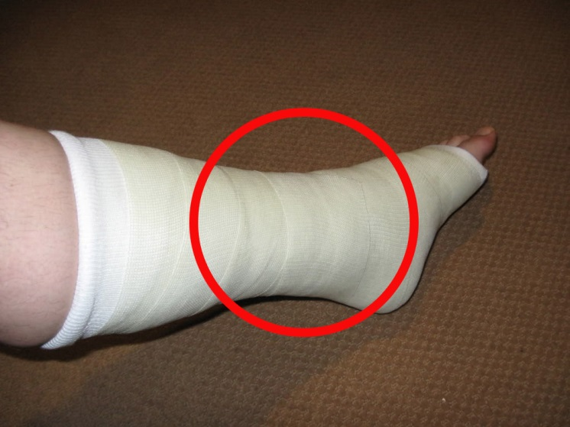
a) I twisted my ankle. b) I’ve got a bruise. c) I’m pregnant.
What can you see in the picture?

Slide 4
a) painful tonsils b) mumps c) indigestion
What can you see in the picture?

Slide 5
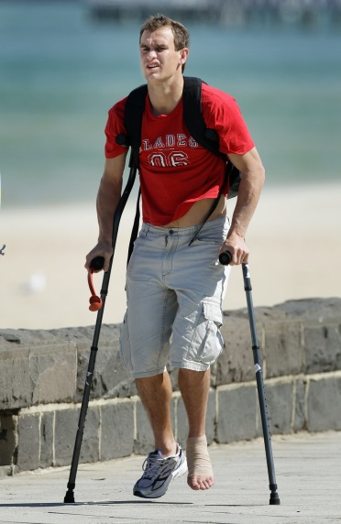
a) That will need some stitches. b) You will have to use crutches. c) You have the symptoms of chickenpox.
What can you see in the picture?

Slide 6
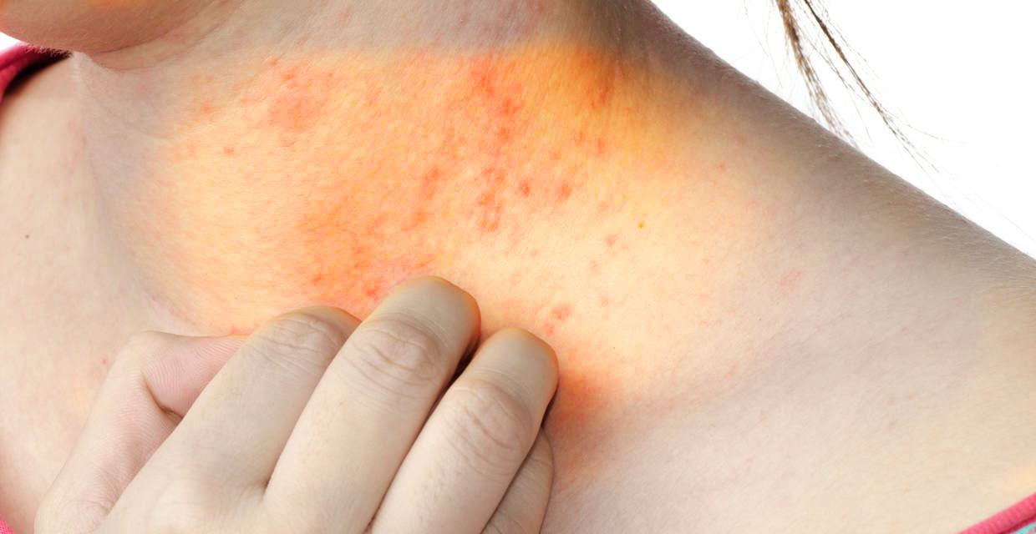
a) I have a rash. b) My arm is swollen. c) I have a cough.
What can you see in the picture?

Slide 7
Fill in the gaps with the appropriate words.

Slide 8
What’s the
_ _ _ _ _ _?

Slide 9
Take one _ _ _ _, once a day with food.

Slide 10
We’ll need to
put it in
_ _ _ _ _ _ _.

Slide 11
You need to
get an
i _ _ _ _ _ _ _ _.

Slide 12
I will need to
give you a
p _ _ _ _ _ _ _ _ _ _ _.

Slide 13
Where does it _ _ _ _?

Slide 14
Pronunciation

Slide 15
What’s the word?
/ˌhaɪpəʊˈkɒndriæ/

Slide 16
What’s the word?
/njuːˈməʊniə/

Slide 17
What’s the word?
/ˈfiːmə(r)/

Slide 18
What’s the word?
/ˈnɔːziə/

Slide 19
Revision
Definitions

Slide 20
What do you remember?
Define the following words:
bruise
indigestion
nausea
prescription
crutches

Slide 21
Thank you!

